Slide 1
Some standard templated classes

Slide 2
Outline
In this lesson, we will:
Describe the insertion sort algorithm
Look at an example
Determine how the algorithm work
Create a flow chart
Implement the algorithm
Look at the run times
Consider some optimizations

Slide 3
Classses
A class is a data structure that stores information, and in general only allows access through member functions
Once you understand this, you can now start to use classes written by other programmers
We will look at a few classes in the Standard Template Library(stl)

Slide 4
The pair class
A pair is a simple class with two items, both of which are public:
#include <iostream>
#include <utility>
int main();
int main() {
std::pair<int, bool> x{1970, true};
std::cout << x.first << std::endl;
std::cout << x.second << std::endl;
x.first = 42; // That's better...
std::cout << x.first << std::endl;
return 0;
}
Output:
1970
1
42

Slide 5
The pair class
Recall we wrote a min-max function:
void min_max( int a, int b, int c, int &min, int &max ) {
if ( a <= b ) {
min = a;
max = b;
} else {
min = b;
max = a;
}
if ( c < min ) {
min = c;
} else if ( c > max ) {
max = c;
}
}

Slide 6
The pair class
We could use a std::pair as a return value:
pair<int, int> min_max( int a, int b, int c ) {
int min, max; // Not initialized
if ( a <= b ) {
min = a;
max = b;
} else {
min = b;
max = a;
}
if ( c < min ) {
min = c;
} else if ( c > max ) {
max = c;
}
return std::make_pair( min, max );
}
A function that creates an instance of a pair<int, int>

Slide 7
The pair class
We could now use this:
int main() {
int numbers[3];
std::pair<int, int> result{};
for ( std::size_t k{0}; k < 3; ++k ) {
std::cout << "Enter an integer: ";
std::cin >> numbers[k];
}
result = min_max( numbers[0], numbers[1], numbers[2] );
std::cout << "The largest number was " << result.second
<< std::endl;
std::cout << "The smallest number was " << result.first
<< std::endl;
return 0;
}

Slide 8
The set class
A set is a collection of elements where repetition and order is ignored
The two sets:
{a, b, c} and {c, b, c, a, a, a, b, a, c, a}
are considered to be the same
You can add new elements or you can remove elements from the set
Adding an element to a set already containing the element leaves the set unchanged

Slide 9
The set class
The Standard Template Library has a set class
This set is templated, so let’s create a set of integers:
#include <iostream>
#include <set>
int main();
int main() {
std::set<int> some_numbers{};
return 0;
}

Slide 10
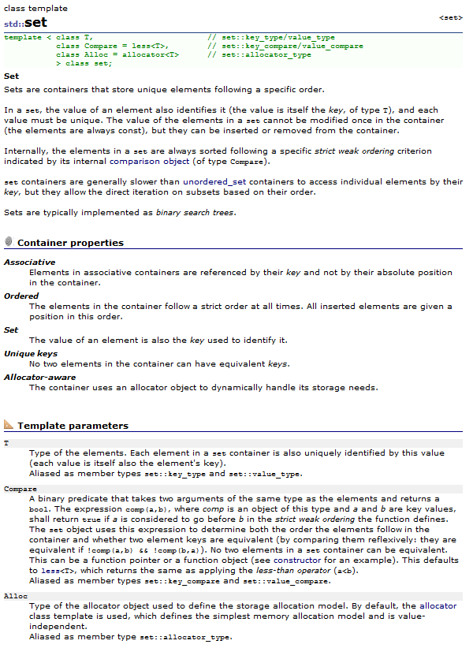
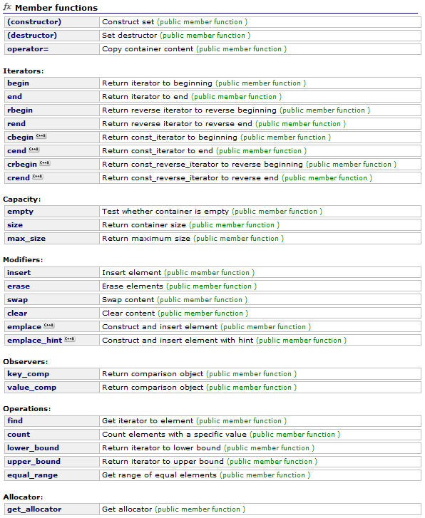
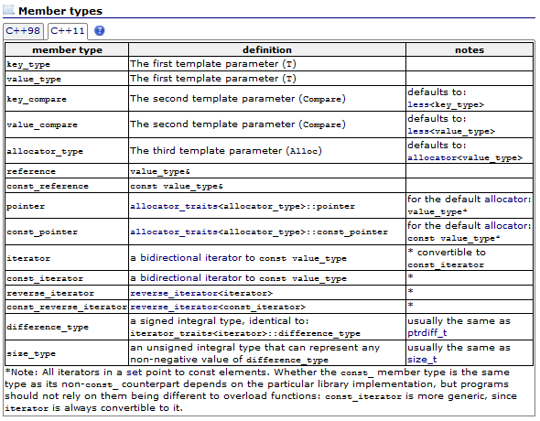
The set class
What can we do with a set?
Fortunately, all this is documented at cplusplus.com
http://www.cplusplus.com/reference/set/set/

Slide 11
The set class
The documentation says nothing about how the class is written
It only documents:
The template parameters
Any types associated with the class
The member functions
We will look at the member functions

Slide 12
The set class
For now, we will focus on only some of the member functions:
Member functions
Capacity
Modifiers
(constructor) | Construct set (public member function)
(destructor) | Set destructor (public member function)
operator= | Copy container content (public member function)
empty | Test whether container is empty (public member function)
size | Return container size (public member function)
max_size | Return maximum size (public member function)
insert | Insert element (public member function)
erase | Erase elements (public member function)
swap | Swap content (public member function)
clear | Clear content (public member function)

Slide 13
std::set::empty
bool empty() const noexcept;
Test whether container is empty
Returns whether the set container is empty (i.e. whether its size is 0)
This function does not modify the container in any way. To clear the contents of a set container, see set::clear
Parameters
none
Return Value
true if the container size is 0, false otherwise.
Complexity
Constant.
Exception safety
No-throw guarantee: this member function never throws exceptions.

Slide 14
std::set::size
size_type size() const noexcept;
Return container size
Returns the number of elements in the set container.
Parameters
none
Return Value
The number of elements in the container.
Member type size_type is an unsigned integral type.
Complexity
Constant.
Exception safety
No-throw guarantee: this member function never throws exceptions.
Note: usually equivalent to size_t

Slide 15
std::set::max_size
size_type max_size() const noexcept;
Return maximum size
Returns the maximum number of elements that the set container can hold.
This is the maximum potential size the container can reach due to known system or library implementation limitations, but the container is by no means guaranteed to be able to reach that size: it can still fail to allocate storage at any point before that size is reached.
Parameters
none
Return Value
The maximum number of elements a set container can hold as content.
Member type size_type is an unsigned integral type.
Complexity
Constant.
Exception safety
No-throw guarantee: this member function never throws exceptions.

Slide 16
std::set::insert
single element (1) | pair<iterator,bool> insert (const value_type& val); pair<iterator,bool> insert (value_type&& val);
with hint (2) | iterator insert (const_iterator position, const value_type& val); iterator insert (const_iterator position, value_type&& val);
range (3) | template <class InputIterator> void insert (InputIterator first, InputIterator last);
initializer list (4) | void insert (initializer_list<value_type> il);
Insert element
Extends the container by inserting new elements, effectively increasing the container size by the number of elements inserted.
Because elements in a set are unique, the insertion operation checks whether each inserted element is equivalent to an element already in the container, and if so, the element is not inserted, returning an iterator to this existing element (if the function returns a value).
For a similar container allowing for duplicate elements, see multiset.
Internally, set containers keep all their elements sorted following the criterion specified by its comparison object. The elements are always inserted in its respective position following this ordering.
The parameters determine how many elements are inserted and to which values they are initialized:

Slide 17
std::set::insert
pair<iterator,bool> insert (const value_type& val);
Parameters
val
Value to be copied (or moved) to the inserted elements.
Member type value_type is the type of the elements in the container, defined in set as an alias of its first template parameter (T).
Return Value
We’ll ignore this…
Complexity
If a single element is inserted, logarithmic in size in general, but amortized constant if a hint is given and the position given is the optimal.
Exception safety
If a single element is to be inserted, there are no changes in the container in case of exception (strong guarantee).
Otherwise, the container is guaranteed to end in a valid state (basic guarantee).

Slide 18
std::set::erase
size_type insert (const value_type& val);
Erase elements
Removes from the set container either a single element or a range of elements.
This effectively reduces the container size by the number of elements removed, which are destroyed.
Parameters
val
Value to be removed from the set.
Member type value_type is the type of the elements in the container, defined in set as an alias of its first template parameter (T).
Return Value
For the value-based version (2), the function returns the number of elements erased.
Member type size_type is an unsigned integral type.

Slide 19
std::set::erase
size_type insert (const value_type& val);
Complexity
For the second version (erase(val)), logarithmic in container size.
Exception safety
If a single element is to be inserted, there are no changes in the container in case of exception (strong guarantee).
Otherwise, the container is guaranteed to end in a valid state (basic guarantee).

Slide 20
Using a set
std::set<int> squares{};
for ( int k{0}; k < isqrt( 2147483647 ); ++k ) {
squares.insert( k*k );
}
std::cout << "There are " << squares.size() << " perfect squares"
<< std::endl;
for ( int k{0}; k <= 13; ++k ) {
std::size_t result{squares.erase( k )};
if ( result == 1 ) {
std::cout << k << " was erased" << std::endl;
}
}
std::cout << "There are " << squares.size() << " perfect squares left"
<< std::endl;
Output
There are 46340 perfect squares
0 was erased
1 was erased
4 was erased
9 was erased
There are 46336 perfect squares left

Slide 21
Maximum size
What is the maximum size?
std::set<int> squares{};
std::cout << "Maximum size: " << squares.size() << std::endl;
This was run on a 64-bit processor, so there are 2⁶⁴ addressable bytes available:
Thus, this implementation of std::set<int> requires 40 bytes per entry
Output
461168601842738790

Slide 22
Membership in the set
std::set<int> squares{};
for ( int k{0}; k < 46340; ++k ) {
squares.insert( k*k );
}
for ( int k{0}; k <= 13; ++k ) {
std::set<int>::iterator result{ squares.find( k )};
if ( result != squares.end() ) {
std::cout << k << " is in the set" << std::endl;
}
}
This is a class associated
with the set<int> class
A member function
returning a specific
iterator
Output
0 is in the set
1 is in the set
4 is in the set
9 is in the set

Slide 23
Some other classes
There are three other classes that are related:
std::multiset Like a set, but allows multiple copies
std::map Like a set, but stores pairs of data,
keyed on the first entry with no
duplication of keys.
std::multimap Like a multimap, but allows multiple
copies of the keys

Slide 24
A stack class
The std::stack class is also straight-forward:
Think of a stack of plates:
You can only take a plate off the top,
You can only put new plates on top, and
The plate you take off is the last plate that was put on top
Last-in—first-out
(constructor) | Construct stack (public member function)
empty | Test whether container is empty (public member function)
size | Return size (public member function)
top | Access next element (public member function)
push | Insert element (public member function)
pop | Remove top element (public member function)

Slide 25
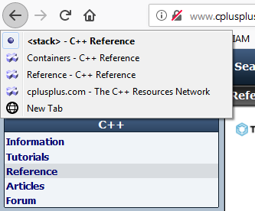
A stack class
Where would you use a stack?
Think of an undo button (Ctrl-z)
When you make a change, the change you made must be stored
When you undo a change, you undo the last change that was made
Also think of the navigate-back button on a web browser
When you go back, you go back to the most recent web page you visited

Slide 26
Using a stack
std::stack<int> data;
data.push( 42 );
std::cout << "Top: " << data.top() << std::endl;
data.push( 91 );
std::cout << "Top: " << data.top() << std::endl;
data.push( 150 );
std::cout << "Top: " << data.top() << std::endl;
std::cout << "Size: " << data.size() << std::endl;
data.pop();
std::cout << "Top: " << data.top() << std::endl;
std::cout << "Size: " << data.size() << std::endl;
data.pop();
data.pop();
std::cout << "Empty?: " << data.empty() << std::endl;
std::cout << "Size: " << data.size() << std::endl;
Output:
Top: 42
Top: 91
Top: 150
Size: 3
Top: 91
Size: 2
Empty?: 1
Size: 0

Slide 27
Important concept
You don’t have to understand the implementation to use classes
Often, you can look for examples on-line to guide you as to the use of the class
The majority of all work you will do will be uses other programmer’s classes
Don’t re-invent the wheel…
In your algorithms and data structures course, you will cover:
How each of these classes are implemented

Slide 28
Summary
Following this lesson, you now
Understand the insertion sort algorithm
You saw an example
Watched how to convert the flow chart to an algorithm
There is a lot of time spent swapping, which can be reduced significantly
The run time is still approximately the same as selection sort

Slide 29
References
[1] No references?

Slide 30



Colophon
These slides were prepared using the Georgia typeface. Mathematical equations use Times New Roman, and source code is presented using Consolas.
The photographs of lilacs in bloom appearing on the title slide and accenting the top of each other slide were taken at the Royal Botanical Gardens on May 27, 2018 by Douglas Wilhelm Harder. Please see
https://www.rbg.ca/
for more information.

Slide 31
Disclaimer
These slides are provided for the ece 150 Fundamentals of Programming course taught at the University of Waterloo. The material in it reflects the authors’ best judgment in light of the information available to them at the time of preparation. Any reliance on these course slides by any party for any other purpose are the responsibility of such parties. The authors accept no responsibility for damages, if any, suffered by any party as a result of decisions made or actions based on these course slides for any other purpose than that for which it was intended.

